Slide 1
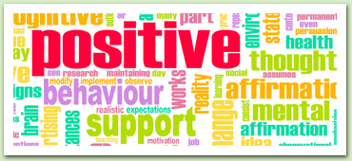
Positive Behaviour Support

Slide 2
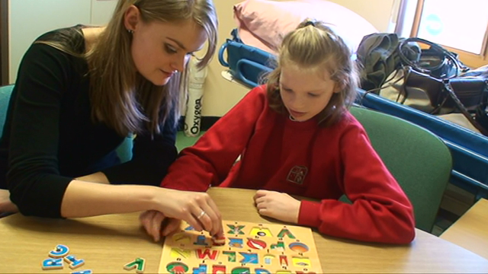
Part One: What is Positive Behaviour Support (PBS)

Slide 3
Who am I? What do I do?
Becca Keller, M.Ed, BCBA
A BCBA is a Board Certified Behaviour Analyst
A BCBA must have:
Master’s degree in Education, Psychology, or Applied Behaviour Analysis
Approved coursework from a qualifying accredited university
Experience hours under the supervision of a BCBA
Pass the board exam

Slide 4
What does a BCBA do?
Train parents
Train Behaviour Interventionists
Conduct assessments and determine behavioural goals
Write behaviour programs
Consistently monitor and update programs as needed
Supervise implementation of ABA programs

Slide 5
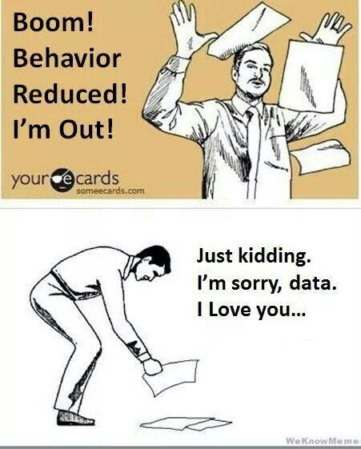
What is PBS?
Based out of Applied Behaviour Analysis (using the science of behaviour and applying it to socially significant behaviours
Highly data driven
Focused on observable, measurable behaviour
Emphasizes the prevention of challenging behaviours
Modifies the environment to support the learner

Slide 6
Behaviour
The Basics

Slide 7
What is Behaviour?
Behaviour is anything anyone says or does
A good behaviour plan will have strategies for both behaviour reduction and skill building

Slide 8
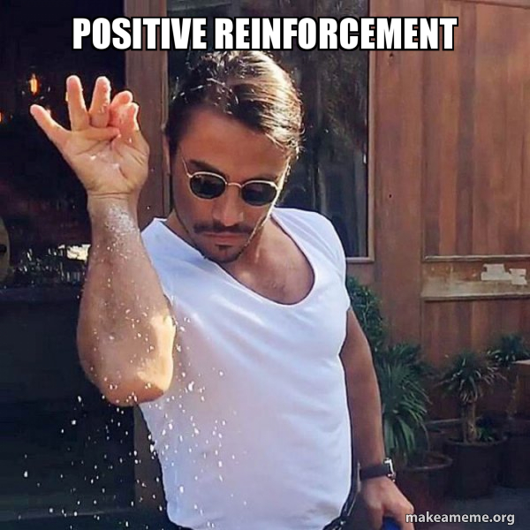
Principles of Behaviour
Reinforcement | Punishment
Anything that increases future behaviour | Anything that decreases future behaviour
*We have no control over behaviour that has already occurred. All we can do is manipulate the environment to make it more or less likely that that behaviour will occur again.

Slide 9
Reinforcement

Slide 10
Examples of Reinforcement and Punishment
Reinforcement:
A child makes a joke and you laugh. As a result, that child makes more jokes.
A child makes a joke and you scold him. As a result, he makes more jokes.
Punishment:
A child answers a question and you say, “no that’s wrong!” He answers your questions less in the future
A child answers a question and you say, “Great job!”. He answers your questions less in the future

Slide 11
Types of Reinforcement and Punishment
Positive Reinforcement -Something is added that increases the likelihood that a behaviour will occur again in the future | Negative Reinforcement -Something is removed that increases the likelihood that a behaviour will occur again in the future
Positive Punishment -Something is added that decreases the likelihood that a behaviour will occur again in the future | Negative Punishment -Something is removed that decreases the likelihood that a behaviour will occur again in the future
Pro Tip: If you ever want to drive a Behaviour Analyst crazy, just use the terms “negative reinforcement” and “punishment” interchangeably

Slide 12
Why do challenging behaviours happen?
What can we do?

Slide 13
Functions of behaviour
All behaviours happen for a reason
Behaviours do not just happen
Based on learning history
We need to know the function
All behaviour is communication
The four main functions of behaviour are:
Attention
Tangible
Escape
Automatic Reinforcement

Slide 14
Attention
A behaviour happens to gain the attention of another person
Examples:
Every time a child yells, his mother picks him up
When a child shouts “boo!” in the middle of class, all the kids look at him

Slide 15
Attention

Slide 16
Tangible
A behaviour occurs in order for an individual to gain access to a tangible item
Examples:
I give the cashier at the grocery store a loonie so that he will give me a chocolate bar
A child hits his brother, and his brother gives him his toy

Slide 17
Escape
A behaviour occurs so that an individual can escape or avoid something aversive
Examples:
I wear shoes outside so that my feet won’t get scraped
When given a math test, a child screams so that the math test gets taken away

Slide 18
Automatic Reinforcement
A behaviour occurs because the act of doing it is reinforcing to the individual. The behaviour will occur both in the presence of others, and when the individual is alone
Examples:
I crack my knuckles
A child with autism flaps his hands

Slide 19
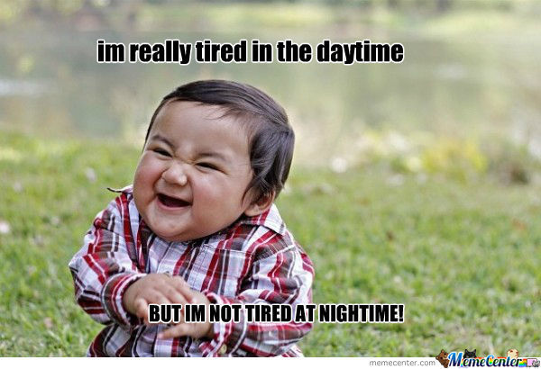
Setting Events
A setting event is something that makes it more likely that an antecedent (trigger) will evoke a behaviour
Setting events could be:
Lack of sleep
No breakfast
Change in schedule
If a setting event has happened, lower task demands and avoid the antecedent if possible
Communication is key!

Slide 20
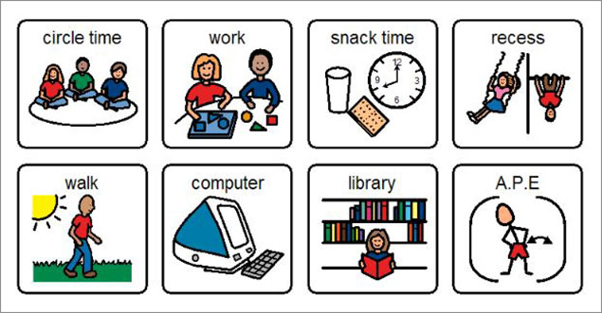
PBS Strategies: Prevention
Arrange the environment in order to prevent the behaviour in the first place
Important because:
Reduce the likelihood of harm
Create pleasant atmosphere
Increase student motivation
Enhance instructional environment
Can be used in a wide variety of situations/for a wide variety of students

Slide 21
PBS Strategies: Prevention
Arrange the environment in order to prevent the behaviour in the first place
Offer choices
Provide a schedule (use visuals)
Increase predictability
Give warnings before transitions
Incorporate child preferences into the activity
Use precorrection (“remember, if you need help, say “help”)
Alternate between preferred and unpreferred task

Slide 22
PBS Strategies: Prevention
Arrange the environment in order to prevent the behaviour in the first place
Don’t say no, say when
Pivot praise
Phrase things positively (we walk in the halls vs. don’t run)
Have clear instructions/explanations
Alter task length
Enrich sensory environment
Use behavioural momentum

Slide 23
Consequence Strategies
Reinforce, reinforce, reinforce!
Find out what is reinforcing for a particular individual, and use it
When to reinforce?
Catch the child being good
Prompt the appropriate behaviour and reinforce it
What is reinforcing for one person is not necessarily reinforcing for another. Know your learner
Use behaviour specific praise

Slide 24
Questions?

